Slide 1
Out-of-Distribution Detection Using Union of 1-Dimensional Subspaces
Feb 8, 2022
Gwangwoo Kim

Slide 2
Contents
1. Introduction
2. Enforcing the Structural Constraints
3. Out-of-distribution Detection Test
4. Experiments
5. References

Slide 3
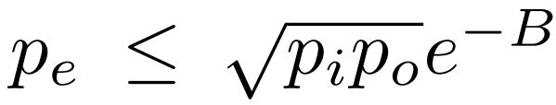
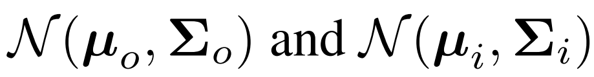
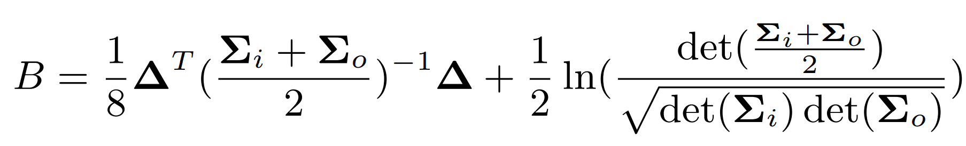
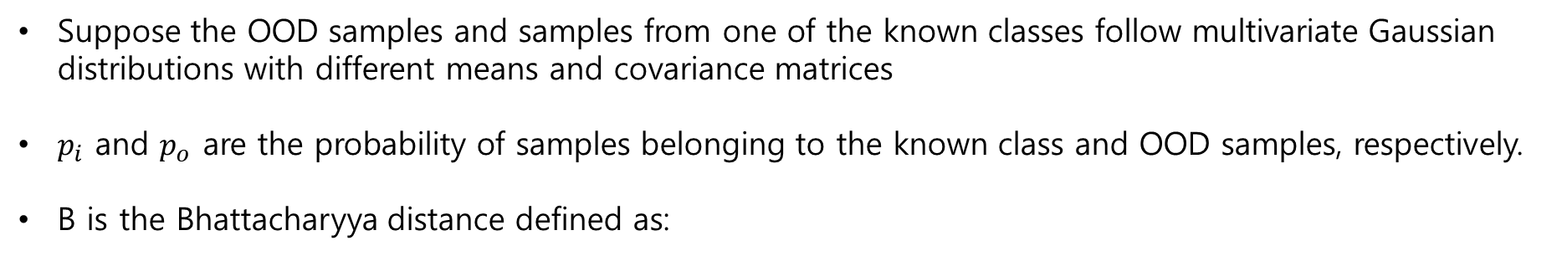
1. Introduction
Toward a tight upper bound for the error probability of the binary Gaussian classification problem.
Suppose the OOD samples and samples from one of the known classes follow multivariate Gaussian distributions with different means and covariance matrices
$p_{i}$ and $p_{o}$ are the probability of samples belonging to the known class and OOD samples, respectively.
B is the Bhattacharyya distance defined as:

Slide 4
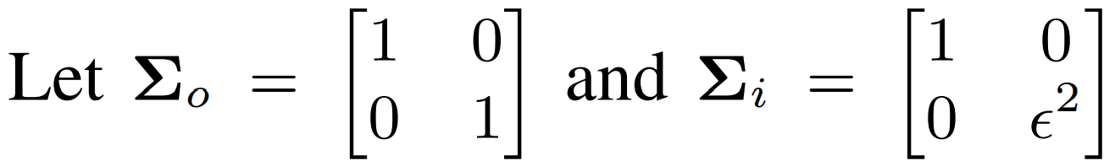
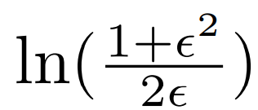
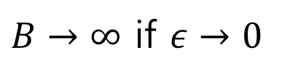
1. Introduction
We don’t know $p_{e},p_{i},p_{o},μ_{o},Σ_{o}$. But $μ_{i},Σ_{i}$ can be controlled by our construction. We want to minimize $p_{e}$.
Example 1:
$B→∞$ if $ε→0$

Slide 5
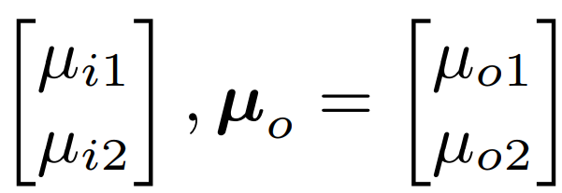
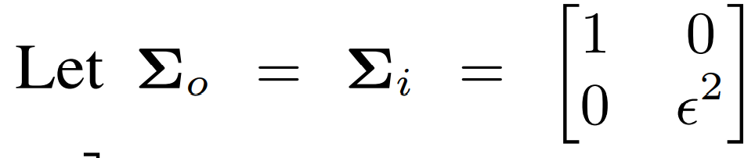
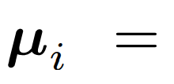
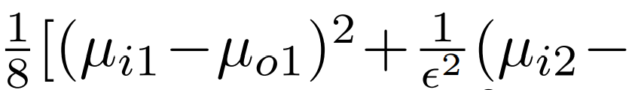
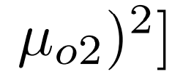
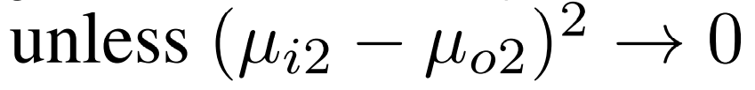
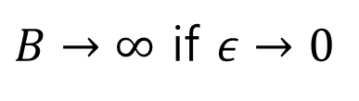
1. Introduction
We don’t know $p_{e},p_{i},p_{o},μ_{o},Σ_{o}$. But $μ_{i},Σ_{i}$ can be controlled by our construction. We want to minimize $p_{e}$.
Example 2:
0
$B→∞$ if $ε→0$

Slide 6
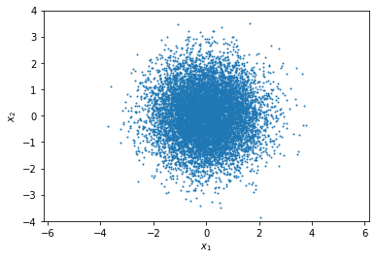
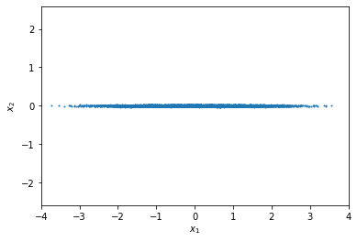


1. Introduction
Motivated by two examples, we will extract features of data which are form of a one-dimensional vector.

Slide 7


2. Enforcing the Structural Constraints
Suppose we have N data and they are labeled in one of L classes
Pick data which are labeled by a class $l$
(and use the same notation N)

Slide 8
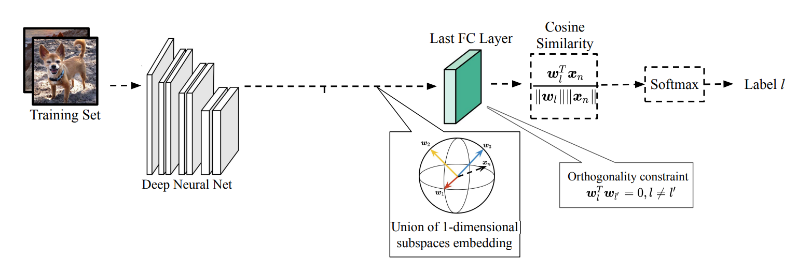

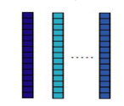

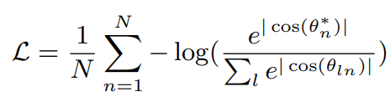
2. Enforcing the Structural Constraints

Slide 9
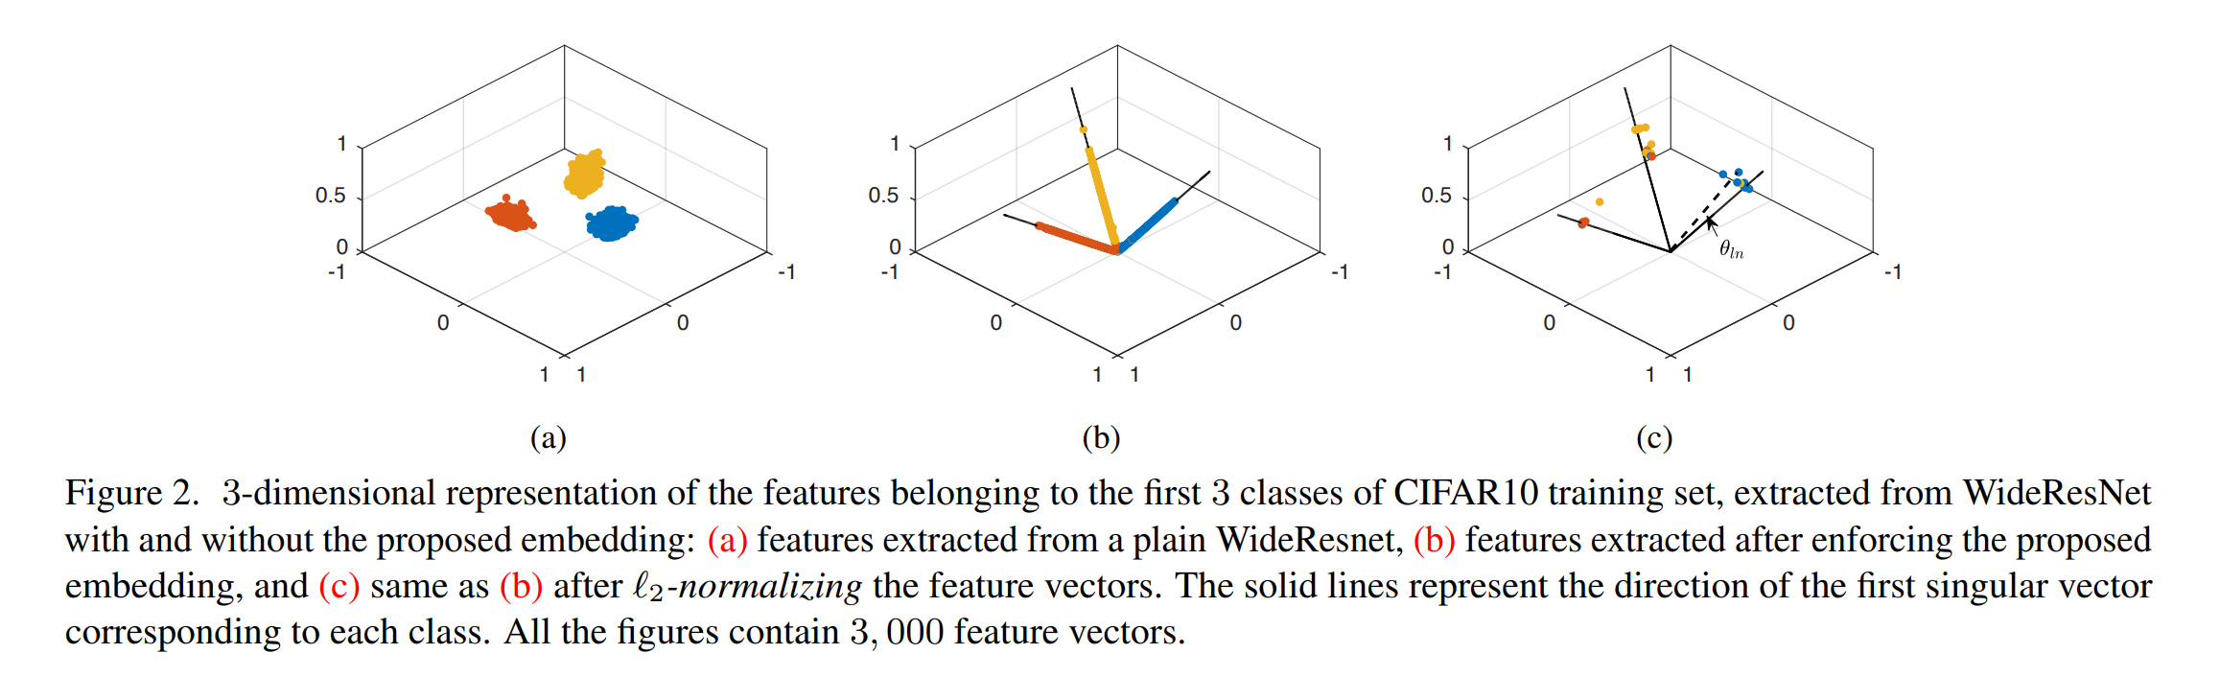
2. Enforcing the Structural Constraints

Slide 10
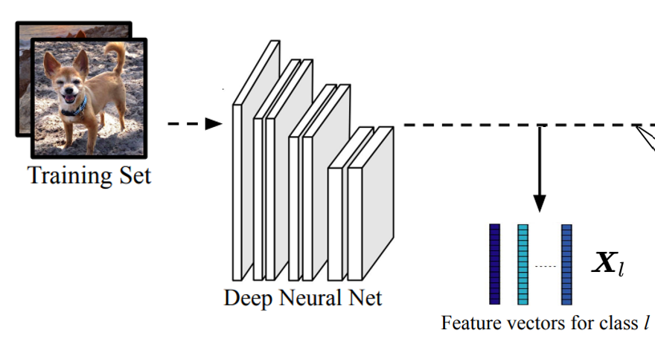
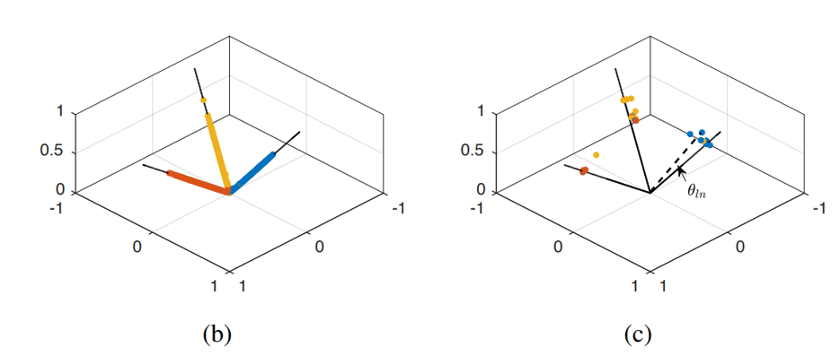
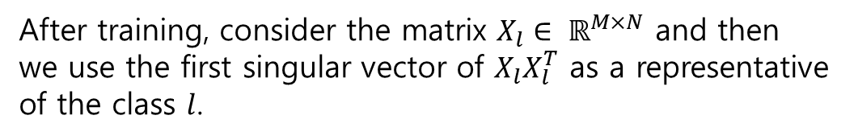
3. Out-of-distribution Detection Test
After training, consider the matrix $X_{l}∈ ℝ^{M×N}$ and then
we use the first singular vector of $X_{l}X_{l}^{T}$ as a representative of the class $l$.
The solid lines represent the direction of the first singular vector corresponding to each class.

Slide 11
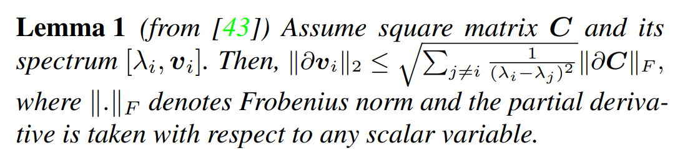
3. Out-of-distribution Detection Test
The first singular component $v_{1}$ is the least sensitive direction to the perturbations.
in many scenarios, the gap between consecutive eigenvalues is decreasing

Slide 12
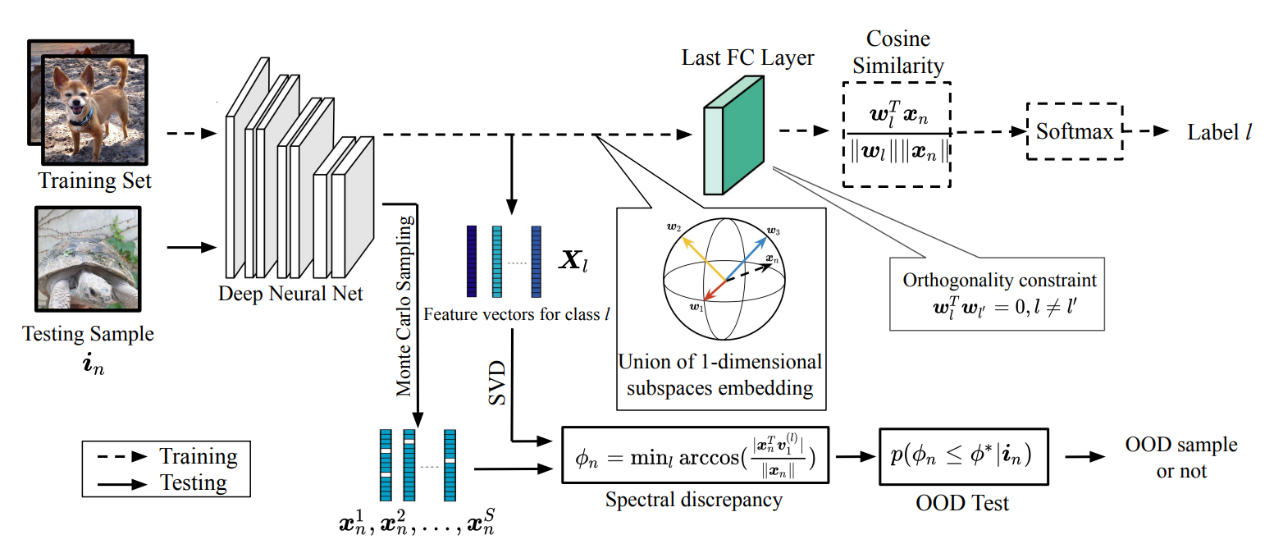
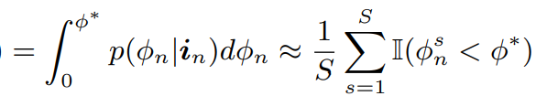
3. Out-of-distribution Detection Test

Slide 13
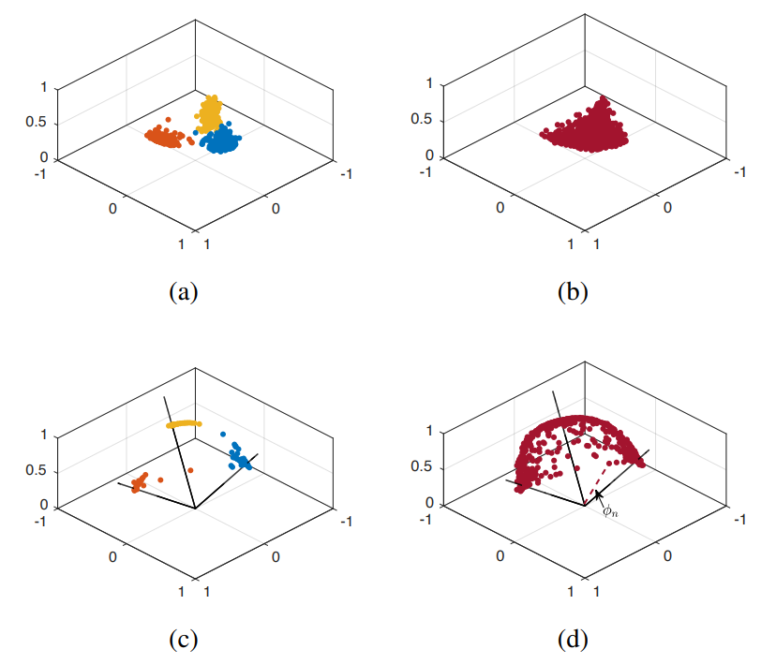
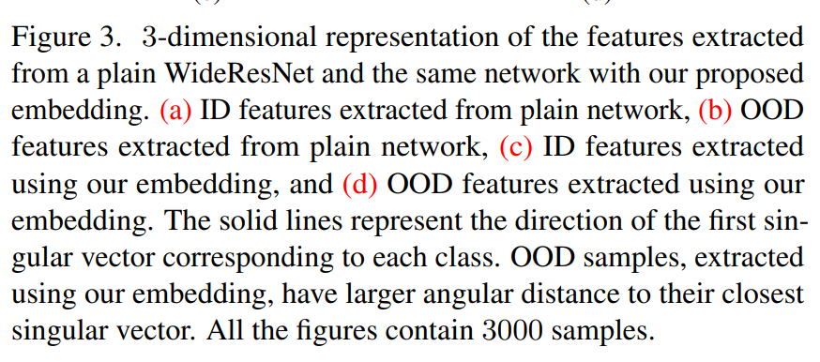
3. Out-of-distribution Detection Test

Slide 14
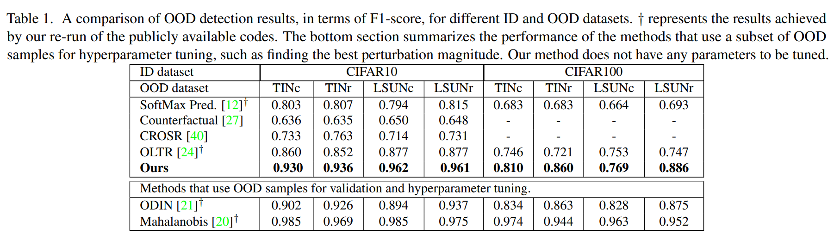
4. Experiments

Slide 15
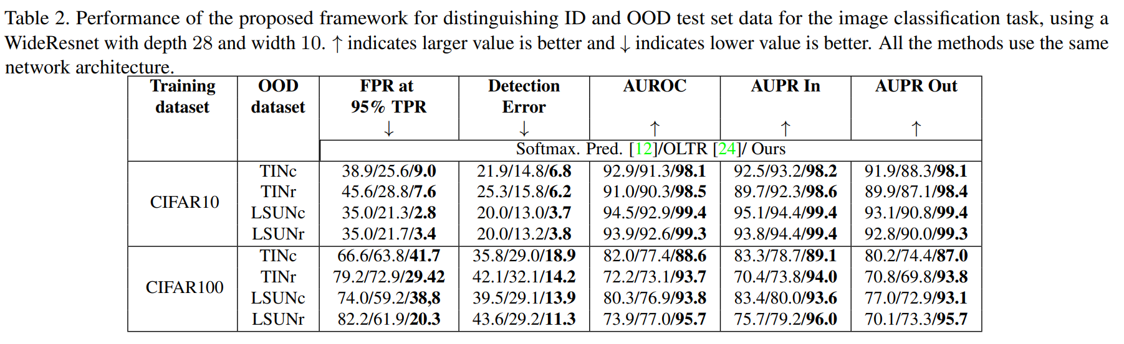
4. Experiments

Slide 16
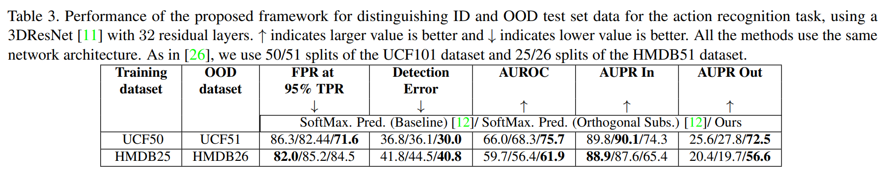
4. Experiments

Slide 17
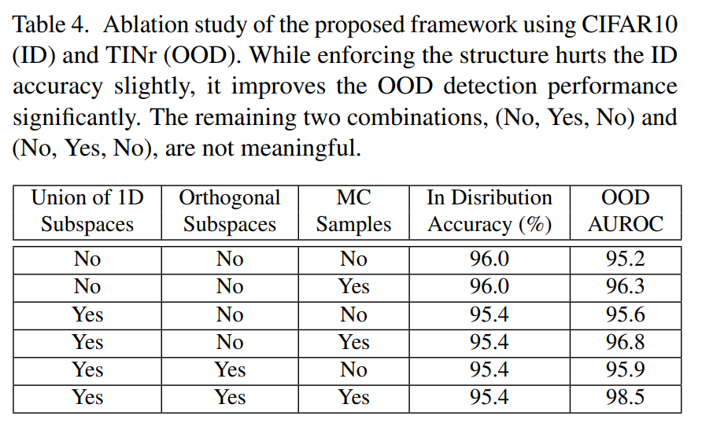
4. Experiments

Slide 18
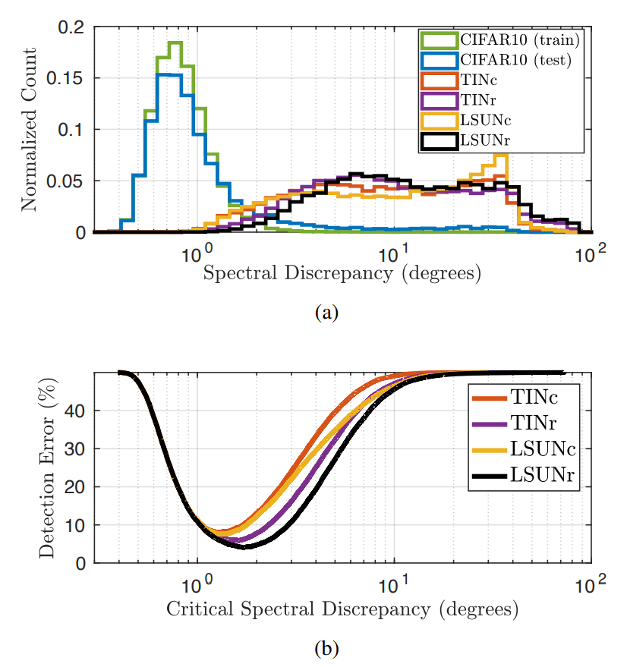
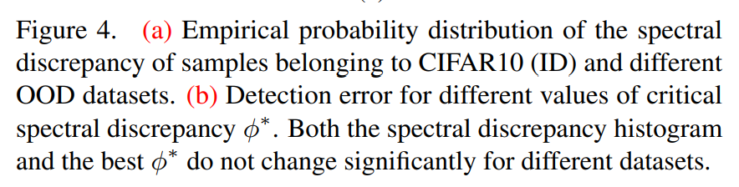
4. Experiments

Slide 19
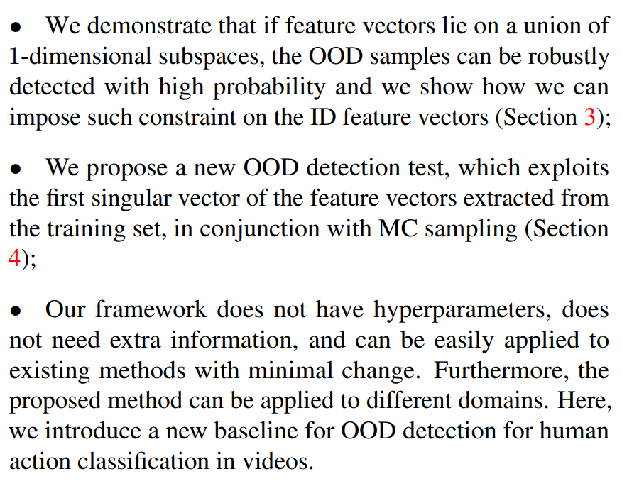
4. Conclusion

Slide 20
5. References
[1] Zaeemzadeh, A., Bisagno, N., Sambugaro, Z., Conci, N., Rahnavard, N., & Shah, M. (2021). Out-of-Distribution Detection Using Union of 1-Dimensional Subspaces. In Proceedings of the IEEE/CVF Conference on Computer Vision and Pattern Recognition (pp. 9452-9461).
[2] Moataz M.H. El Ayadi, Mohamed S. Kamel, and Fakhri Karray. Toward a tight upper bound for the error probability of the binary Gaussian classification problem. Pattern Recognition, 2008.
[3] Alireza Zaeemzadeh, Mohsen Joneidi, Nazanin Rahnavard, and Mubarak Shah. Iterative Projection and Matching: Finding Structure-preserving Representatives and Its Application to Computer Vision. The IEEE Conference on Computer Vision and Pattern Recognition (CVPR), 2019.

